Slide 1



Road Accidents
View in Power BI
Last data refresh:
3/20/2024 6:09:31 PM UTC
Downloaded at:
3/20/2024 6:13:25 PM UTC

Slide 2
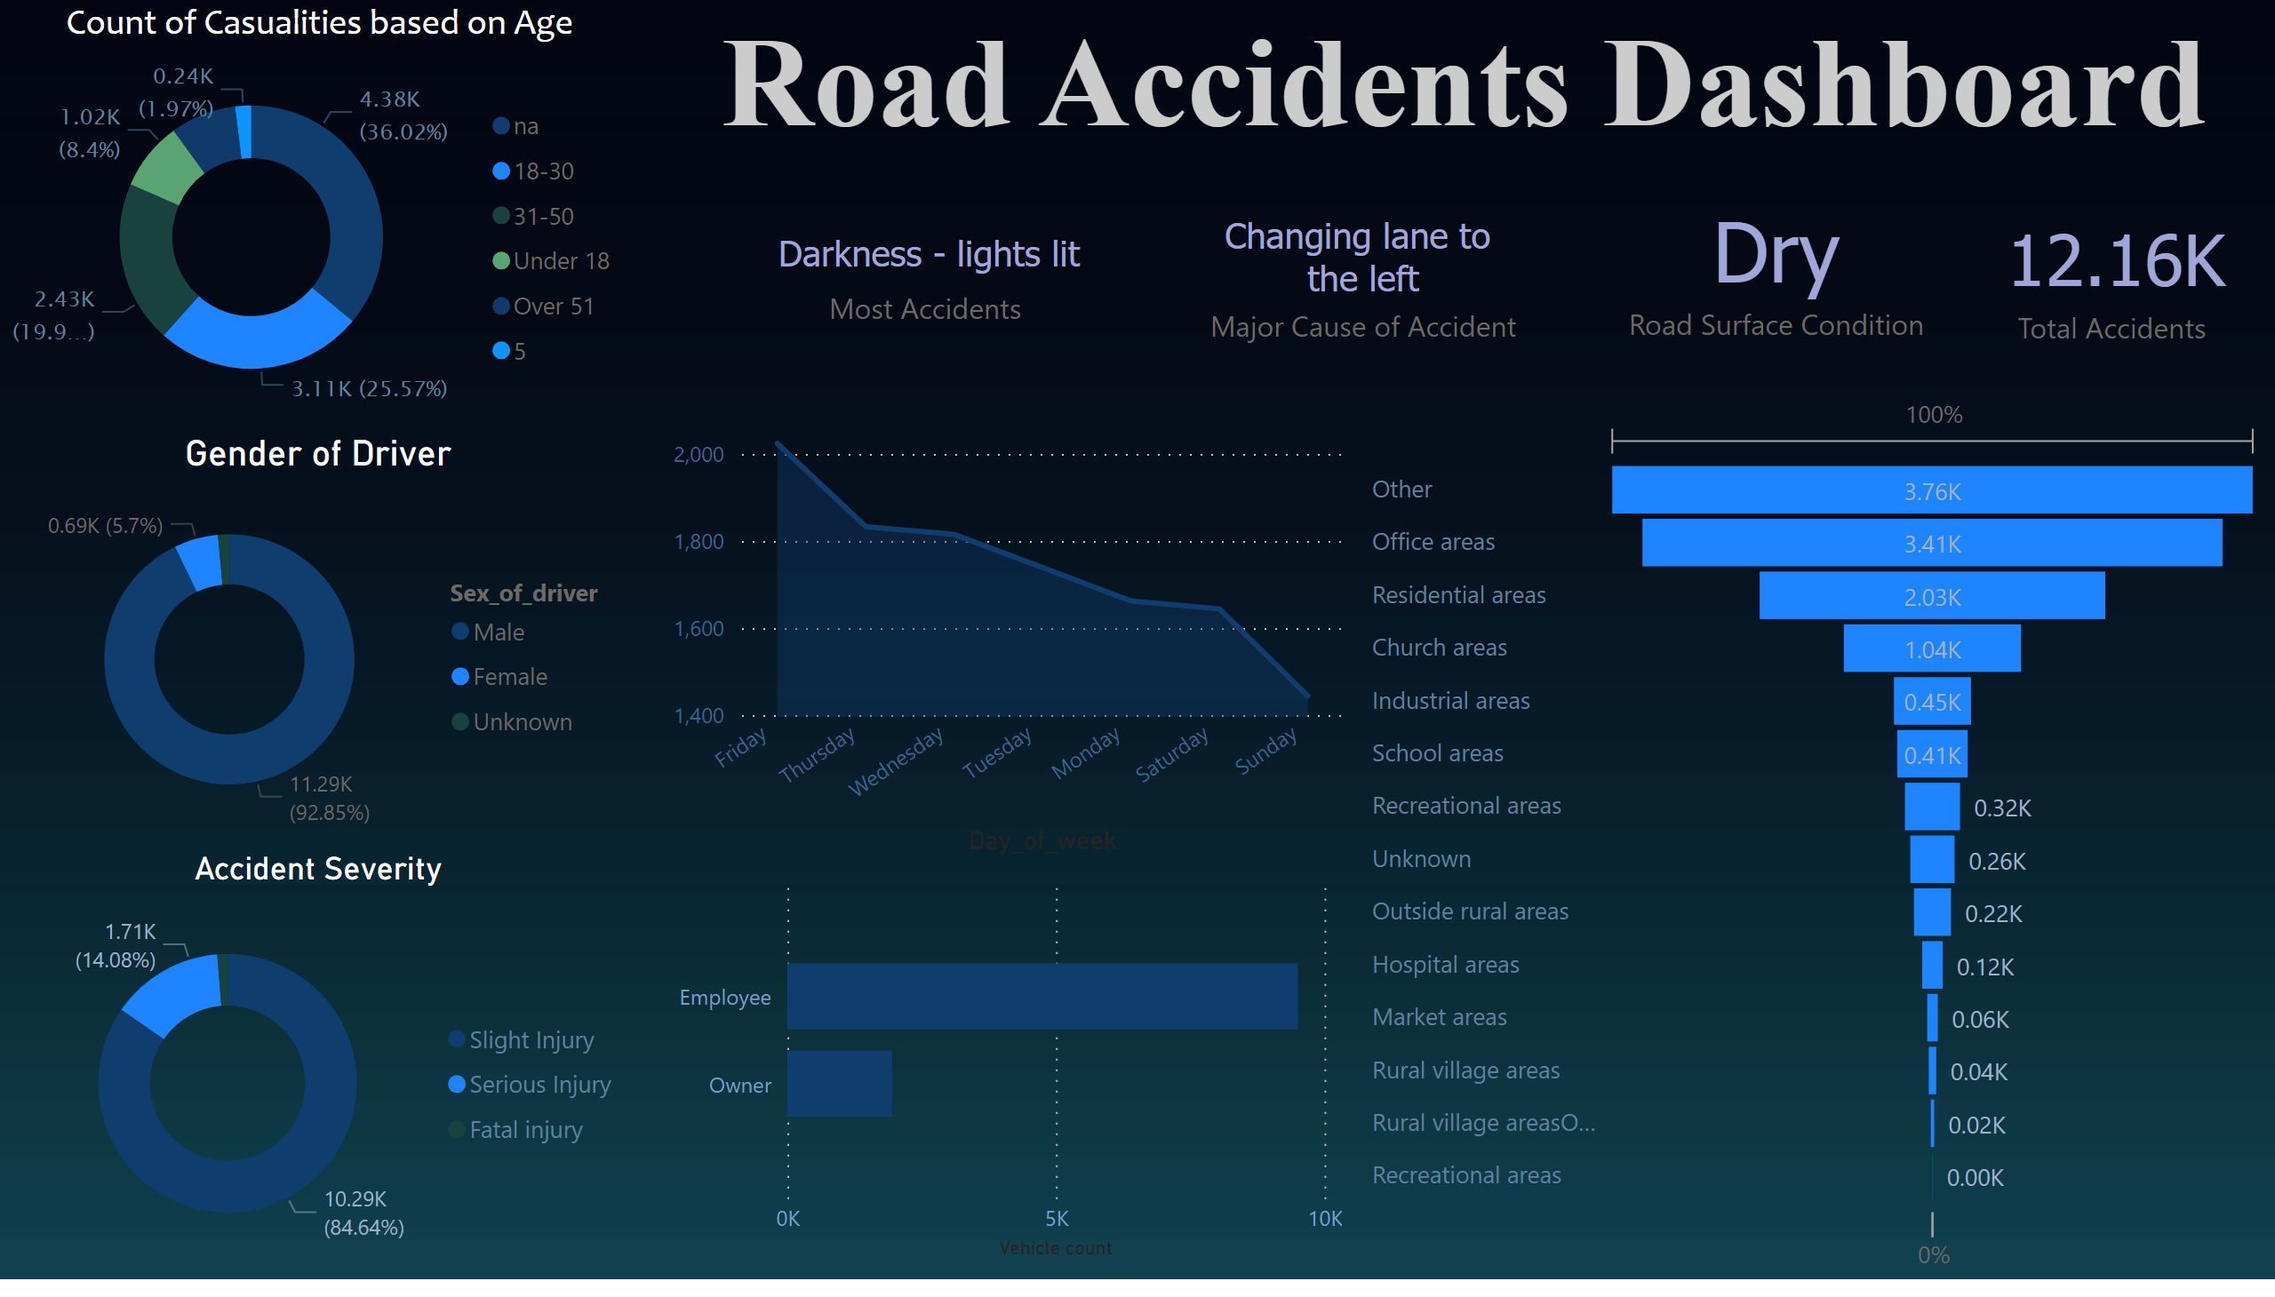
Page 1
Notes:
Count of Casualities based on Age
No alt text provided
Number of Accidents in a Particular Day
No alt text provided
Gender of Driver
No alt text provided
clusteredBarChart
No alt text provided
No alt text provided
Accident Severity
No alt text provided
textbox
No alt text provided
card
No alt text provided
card
No alt text provided
card
No alt text provided
card
No alt text provided

